Slide 1
Automation of Online Cookie Classification
Mitigating Legal Risk
Rodrigo Rodriguez
7/10/2024
Project C Milestone 4
DSC680 (Summer)
Notes:
Hello everyone my name is Rodrigo Rodriguez, and I will be discussing the Automation of Online Cookie Classification to Mitigate Legal Risk.

Slide 2
Introduction – Legal Risk
A legal risk is present by keeping all online cookies enabled on our site.
+1600 Online cookies are currently active across all of our domains.
Cookies must be classified to determine the required level of user consent
Manual classification efforts are too intensive and slow.
Legal Team has set strict deadlines to accomplish classification efforts.
Notes:
Online cookies are used to track certain activities that a user does on our website. This is done for various purposes, Analytics, Website Function, and Marketing are a few of the primary reasons of why cookies are used.
Recent privacy laws like California’s Privacy Protection Act, bring about legal risk of using cookies. Cookies cannot be fully removed from our site because we rely on them for our site to function, but instead we are now meant to gain consent from users before allowing certain types of cookies.

Slide 3
Solution – Data Science Problem
Leverage an NLP model to classify online cookies.
A model is scalable and requires less manual effort.
The model must achieve an 85% accuracy rate.

Slide 4
Data, Variables, and EDA

Slide 5
Data & Variables
Data
Variables
The dataset is sourced internally and contains manually classified online cookies on our primary domain.
The dataset can be used to train an NLP classification model.
Cookie Name
Cookie ID
Source
Lifespan
Hostname
Category
CategoryID
C_Source
Description
Domain
Category Overrides Domains
Data Source
Internal WM Dataset: Online Cookies Manually Classified.

Slide 6
High Value Predictors
Data
Features with high predictive value
Variables
CategoryID: [category variable] The ID of the classified category of the online cookie.
C_Source: [category variable] The source (creator) of the online cookie.
Description: [string object] The description of the intended purpose of the online cookie.

Slide 7
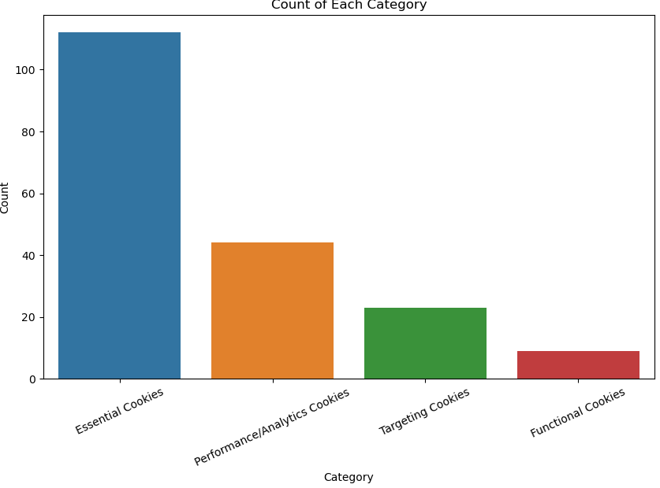
EDA
Summary
Distribution of CategoryID Counts
188 Manually Classified Records
112 Essential Cookies
9 Functional Cookies
44 Performance Cookies
23 Targeting Cookies

Slide 8
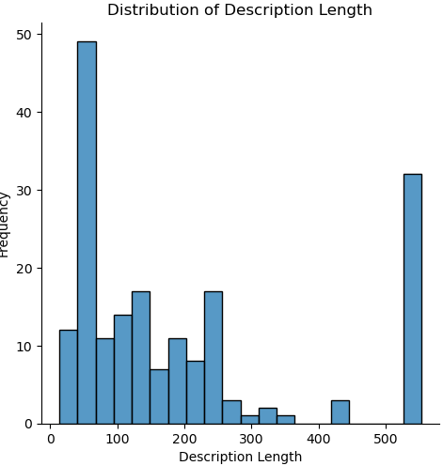
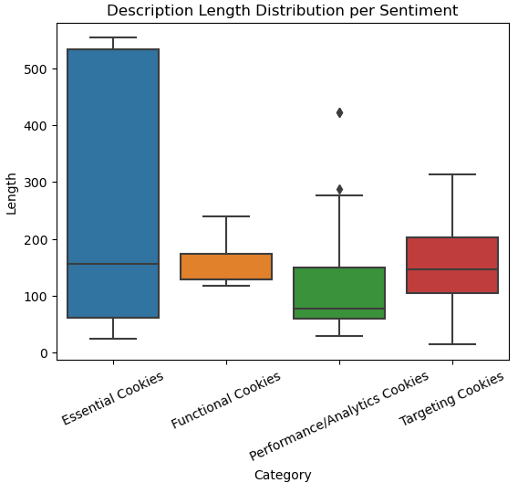
EDA
Distribution of Description Length
Description Length by Category

Slide 9
Methodology

Slide 10
Natural Language Processing
NLP Phase steps
NLP Purposes in ML
Remove HTML
Convert all text to lower case
Remove punctuations / special char.
Remove stop words
Apply word stemmer
Reduce dimensionality and complexity of the data.
Enhances performance by focusing on the most important features of the text.
Notes:
These preprocessing steps are crucial for effectively reducing the dimensionality and complexity of text data. They help in enhancing the performance of the models by focusing on the most informative features of the text. Each step, although it might lead to a loss of some textual details, is generally beneficial for creating a more manageable and analyzable dataset that can yield more accurate and meaningful results in various NLP applications.

Slide 11
NLP Results
Unprocessed Cookie Description
Processed Cookie Description
This cookie is set by the cookie compliance solution from OneTrust. It stores information about the categories of cookies the site uses and whether visitors have given or withdrawn consent for the use of each category. This enables site owners to prevent cookies in each category from being set in the users browser, when consent is not given. The cookie has a normal lifespan of one year, so that returning visitors to the site will have their preferences remembered. It contains no information that can identify the site visitor.
cooki set cooki complianc solut onetrust store inform categori cooki site use whether visitor given withdrawn consent use categori enabl site owner prevent cooki categori set user browser consent given cooki normal lifespan one year return visitor site prefer rememb contain inform identifi site visitor

Slide 12
Modeling Phase
Modeling Phase Steps
Evaluated Models
Split data into training and test sets
Transform using TF-IDF
Concatenate dummy variables
Train and evaluate models
Random Forest Classification
Logistic Regression (OvR) Classification
Naïve Bayes Classifier

Slide 13
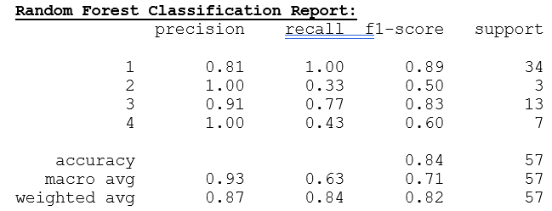
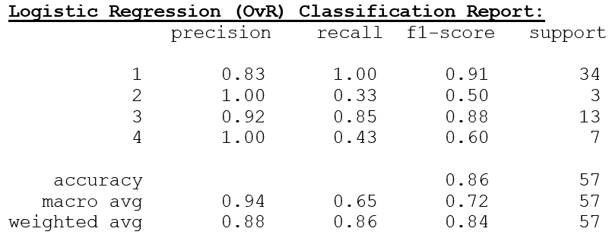
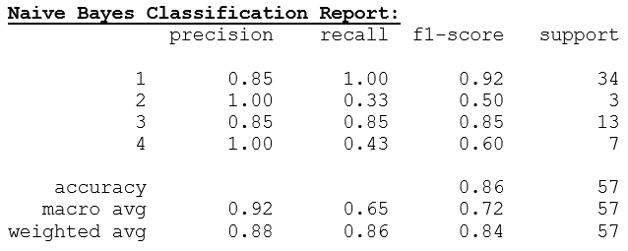
Evaluation
Key Findings
85% Accuracy goal achieved
Class imbalance is affecting performance
Consistently low F1 scores for Class 2 & 4
Logistic Regression is the preferred model

Slide 14
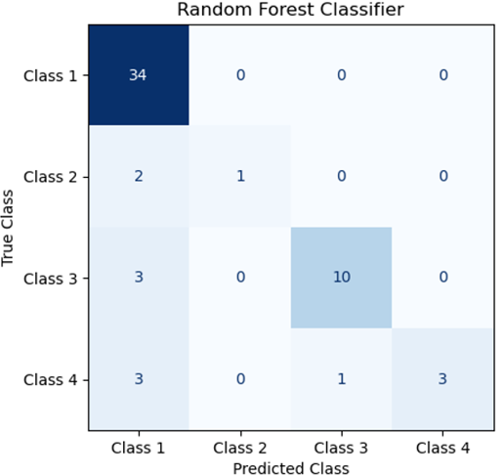
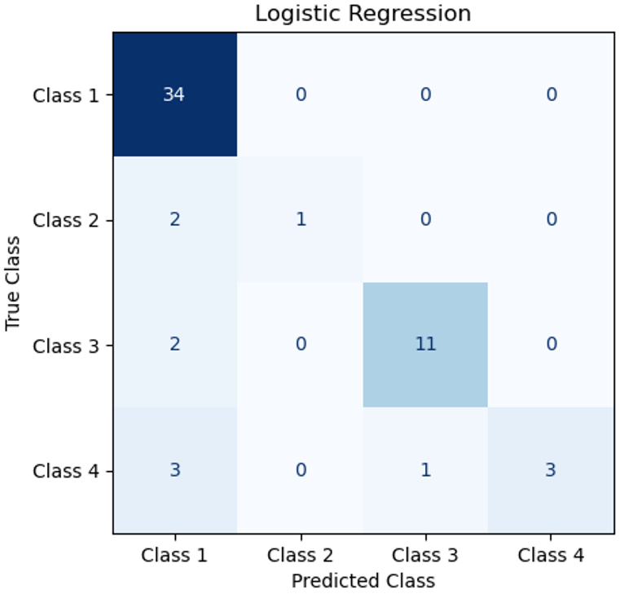

Confusion Matrix
Notes:
All are very similar
Especially Logistic Regression and Naïve Bayes, the only difference is being 1 less false positive in class 1 for LogReg
and 1 less false positive for class 3 Naïve Bayes.
LogReg is preferred for its ability to fine tune hyper parameters
Also, naive Bayes has almost no hyperparameters to tune, so it usually generalizes well. One thing to note is that due to the feature independence assumption, the class probabilities output by naive Bayes can be pretty inaccurate.

Slide 15
Conclusion & Recommendation
85% Accuracy threshold was achieved by two models.
I recommend the models not be deployed as is.
Addressing the class imbalances and tuning hyper parameters for Logistic Regression could greatly improve model performance.
Move forward with improving the Logistic Regression Model.

Slide 16
Sources
Yiu, T. (2019, October 24). Understanding The Naive Bayes Classifier. Towards Data Science. Retrieved May 24, 2024, from https://towardsdatascience.com/understanding-the-naive-bayes-classifier-16b6ee03ff7b#:~:text=Also%2C%20naive%20Bayes%20has%20almost,Bayes%20can%20be%20pretty%20inaccurate.
Pramoditha, R. (2023, November 29). Logistic Regression for Multiclass Classification — 3 Strategies You Need to Know. Medium. Retrieved May 24, 2024, from https://rukshanpramoditha.medium.com/logistic-regression-for-multiclass-classification-3-strategies-you-need-to-know-0a3e74574b96
Komnenic, M. (2022, January 14). The Different Types of Internet Cookies Explained. Termly.io. Retrieved May 24, 2024, from https://termly.io/resources/articles/types-of-internet-cookies/

Slide 17
Thank you
Rodrigo Ivan Rodriguez
7/10/24
Project C Milestone 4
DSC680 (Summer)

